Slide 1
Deep Neural Networks
(AIML ZG511)

Slide 2
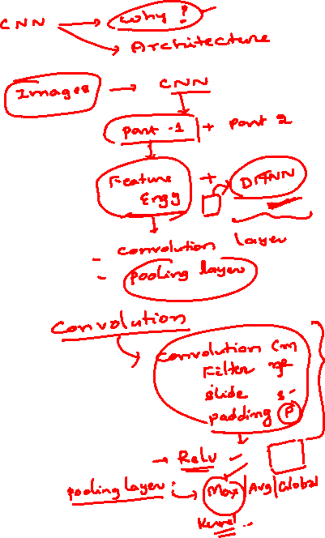
MODULE # 6 :
CNN
Session 9
(5th July,2026)

Slide 3
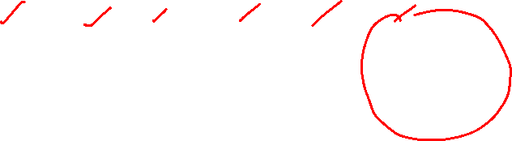
Typical CNN Architecture
32×32×3
28×28×6
14×14×6
10×10×16
5×5×16
120
10
Input
Conv1 Pool1 Conv2 Pool2 FC
Output
Pattern: CONV → POOL →CONV →POOL →FC →OUTPUT
Early layers: Detect low-level features (edges, corners) Middle layers: Combine features (shapes, textures) Later layers: High-level concepts (objects, faces) Spatial size decreases, depth increases

Slide 4
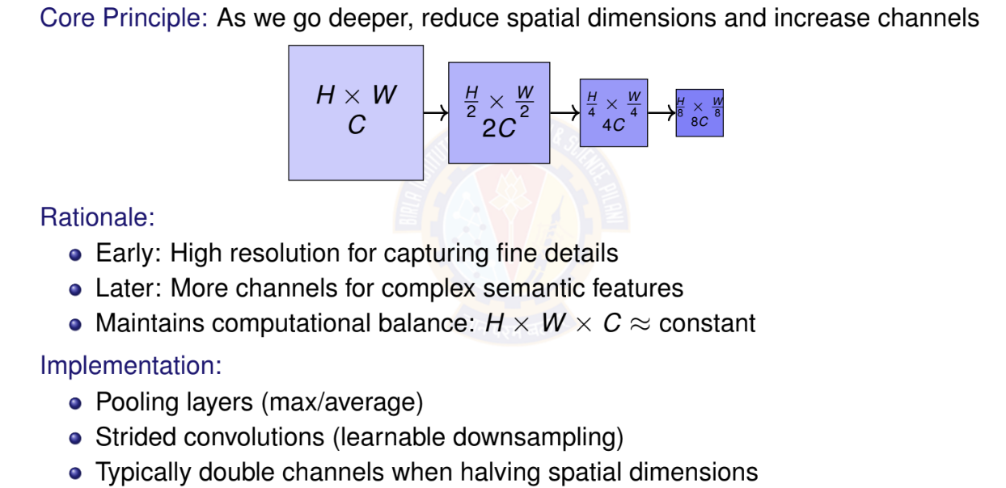
Pattern 1: Spatial Reduction + Channel Expansion

Slide 5
Pattern 2: Repetitive Building Blocks
Instead of arbitrary layers, use repeated modular blocks
VGG Block:
Multiple 3×3 convs + pooling
VGG Block
ResNet Block:
Convs + skip connection
ResNet Block
Conv 3×3
Conv | 3×3
Conv | 3×3
Conv 3×3
MaxPool
+
Benefits: Modularity, easier to scale, proven designs

Slide 6


Pattern 3: Skip/Residual Connections
Problem: Deep networks suffer from vanishing gradients Solution: Add identity shortcuts (skip connections)
F (x)
x Weight Weight +
y
identity
y = F (x) + x
Key Benefits:
Easier gradient flow during backpropagation Network can learn identity mapping if needed
Enables training of very deep networks (100+ layers)
Used in ResNet, DenseNet, U-Net

Slide 7
Pattern 4: Bottleneck Designs
Goal: Reduce computational cost without sacrificing performance
Strategy: Use 1×1 convolutions to reduce dimensions before expensive operations 8× parameter reduction! Used in ResNet-50/101/152, Inception, MobileNet
Standard: Bottleneck:
256 ch
256 ch
1×1 Conv
Conv 3×3
590K params
64 ch
256 ch
Conv 3×3
70K params
64 ch
1×1 Conv
256 ch

Slide 8
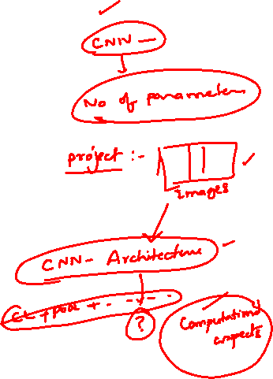
Pattern 5: Multi-Scale Feature Extraction
Idea: Process input at multiple scales simultaneously Inception Module Example:
Concatenate
1×1
3×3
5×5
Pool
Input
Benefits:
Capture features at different scales More robust to object size variations
Network decides which scale is important

Slide 9
How to Choose Architecture Depth
Key Considerations:
1
Task complexity
⁾ Simple: MNIST 5-10 layers sufficient
⁾ Complex: ImageNet 50-152 layers
⁾ Very complex: Medical imaging 100+ layers
Dataset size
⁾ Small dataset (< 10K): Shallow network (avoid overfitting)
⁾ Medium (10K-100K): Moderate depth (20-50 layers)
⁾ Large (> 1M): Very deep (50-200 layers)
Computational budget
⁾ Mobile/edge: MobileNet, EfficientNet (10-20 layers)
⁾ Desktop/server: ResNet-50, VGG-16 (16-50 layers)
⁾ Data center: ResNet-152, EfficientNet-B7 (100+ layers)
2
3
Start shallow, add depth if underfitting and you have enough data

Slide 10
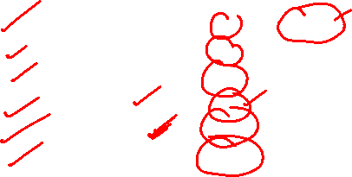
Architecture Depth: Practical Guidelines
Empirical observations:
Network | Layers | Params | Use Case
LeNet-5 | 5 | 60K | MNIST, simple tasks
AlexNet | 8 | 60M | ImageNet (2012)
VGG-16 | 16 | 138M | High accuracy, features
ResNet-50 | 50 | 25M | General purpose
ResNet-152 | 152 | 60M | State-of-art accuracy
EfficientNet-B0 | 18 | 5M | Mobile, efficient
Trends:
Modern architectures: 50-200 layers with skip connections Efficient architectures: 10-30 layers with smart design Depth alone is not enough: Need proper training techniques
Warning: Very deep networks require: Batch normalization

Slide 11
Trade-offs: Depth vs. Width
Depth: Number of layers (vertical stacking)
Width: Number of channels per layer (horizontal expansion)
Aspect | Deeper (More Layers) | Wider (More Channels)
Feature complexity | Higher | Moderate
Receptive field | Larger | Same
Parameters | Sub-linear growth | Quadratic growth
Training difficulty | Harder (vanishing grad) | Easier
Overfitting risk | Lower (if regularized) | Higher
Inference speed | Slower (sequential) | Faster (parallel)
Example:
ResNet-50: Deep (50 layers), moderate width (256-2048 channels) Wide ResNet: Fewer layers (16-28), very wide (up to 10× channels)
Current consensus: Depth + Width both matter; optimal ratio depends on task

Slide 12
Depth vs. Width: Practical Recommendations
When to go deeper:
⁾ Large, diverse datasets (ImageNet, COCO)
⁾ Complex tasks requiring hierarchical features
⁾ When you can use skip connections
⁾ Sufficient computational resources
When to go wider:
⁾ Smaller, more homogeneous datasets
⁾ Need faster training/inference
⁾ Limited to shallow networks (no residual connections)
⁾ Ensemble-like behavior (different filters learn different patterns)
Hybrid approach (EfficientNet):
⁾ Scale depth, width, AND resolution together
⁾ Use compound scaling: depth^{d} × width^{w} × resolution^{r} = 2
⁾ Achieves better accuracy-efficiency trade-off

Slide 13
Design Decision Framework
1
Start with baseline
⁾ Use proven architecture (ResNet, EfficientNet)
⁾ Transfer learning if possible
Estimate requirements
⁾ Dataset size depth constraint
⁾ Computational budget width/depth trade-off
⁾ Input resolution receptive field needs
Iterate systematically
⁾ Underfitting? Add depth or width
⁾ Overfitting? Regularize (dropout, data aug) before reducing capacity
⁾ Too slow? Reduce width or use efficient blocks
Apply design patterns
⁾ Always: Spatial reduction + channel expansion
⁾ Deep networks: Skip connections mandatory
⁾ Tight budget: Bottleneck designs
2
3
4

Slide 14
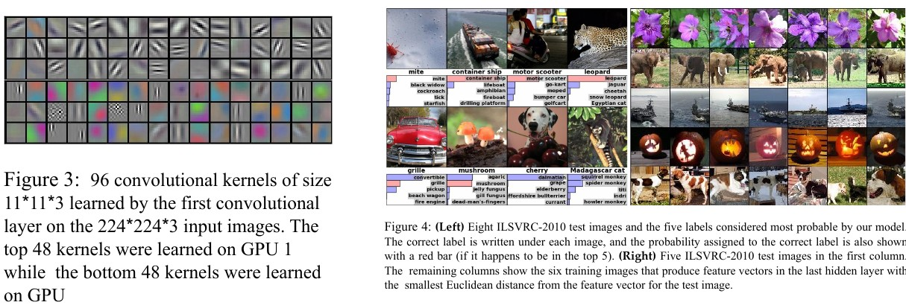
ImageNet Data

Slide 15
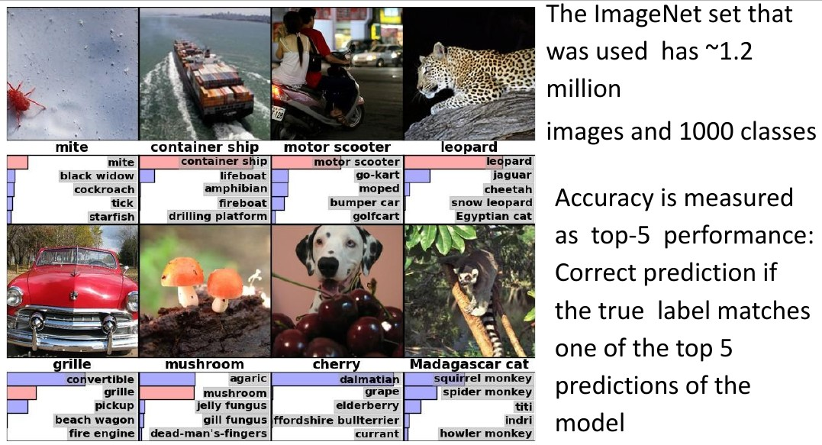
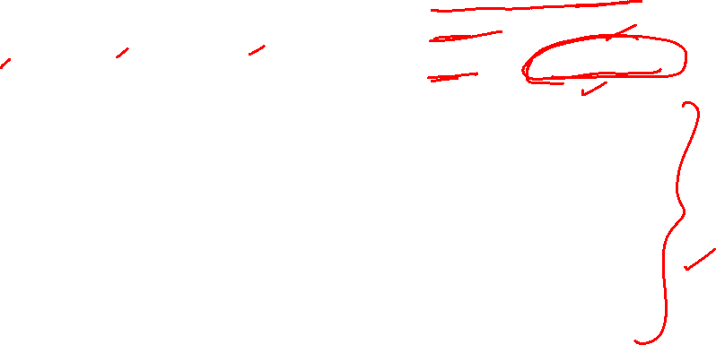
ImageNet Data

Slide 16
AlexNet
AlexNet competed in the ImageNet Large Scale Visual Recognition Challenge on September 30, 2012.[3] The network achieved a top-5 error of 15.3%, more than 10.8 percentage points lower than that of the runner up.
Details/Retrospectives:
first use of ReLU
used Local Response Normalisation (LRN) layers (not common anymore)
Approx. 60 million parameters are learned.
heavy data augmentation
dropout 0.5
batch size 128
SGD Momentum 0.9
Learning rate 1e − 2, reduced by 10 manually
L2 weight decay 5e − 4
7 CNN ensemble: 18.2%− > 15.4%
Fei-Fei Li, Jiajun Wu, Ruohan Gao

Slide 17
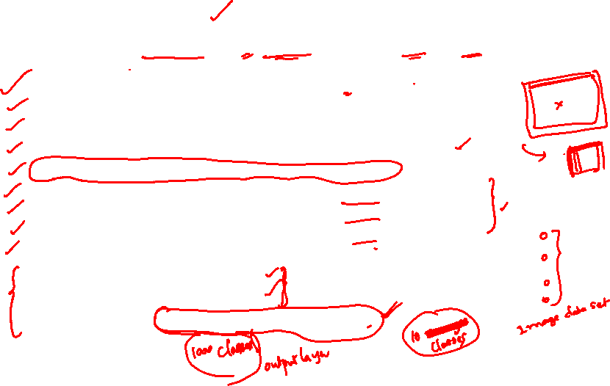
AlexNet Architecture
227x227x3 INPUT
55x55x96 CONV1 : 96 11x11 filters at stride 4, pad 0 27x27x96
MAX POOL1 : 3x3 filters at stride 2 27x27x96
NORM1 : Normalization layer 27x27x256
CONV2 : 256 5x5 filters at stride 1, pad 2 13x13x256
MAX POOL2 : 3x3 filters at stride 2 13x13x256
NORM2 : Normalization layer 13x13x384
CONV3 : 384 3x3 filters at stride 1, pad 1 13x13x384
CONV4 : 384 3x3 filters at stride 1, pad 1 13x13x256
CONV5 : 256 3x3 filters at stride 1, pad 1 6x6x256
MAX POOL3 : 3x3 filters at stride 2
4096 FC6 : 4096 neurons
4096 FC7 : 4096 neurons
1000 FC8 : 1000 neurons (class scores)

Slide 18
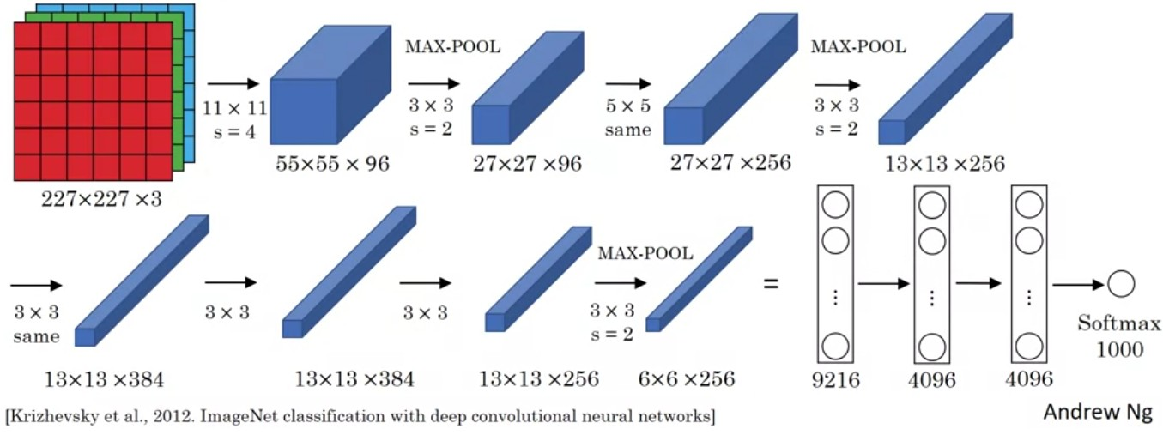
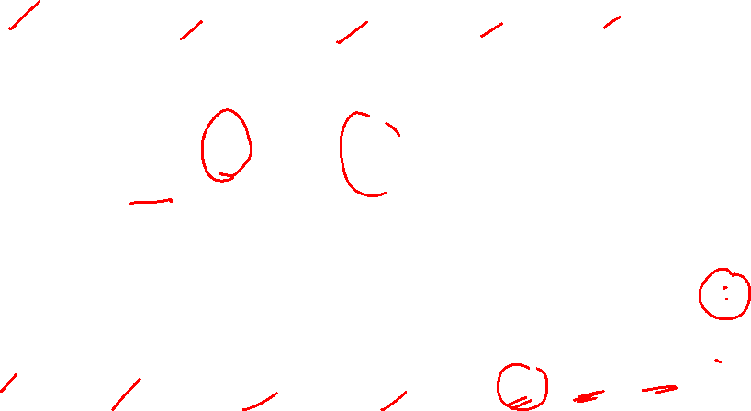
AlexNet

Slide 19
VGG 16
VGG stands for Visual Geometry Group with 16 Layers
Plug and play in Caffe
Deeper the better
Details
ILSVRC’14 2nd in classification, 1st in localization
Similar training procedure as Krizhevsky 2012
Approx. 138 million parameters are learned.
No Local Response Normalisation (LRN)
Use VGG16 or VGG19 (VGG19 only slightly better, more memory)
Use ensembles for best results
All convolutions with a 3 × 3 kernel
All max-pooling layers with a 2 × 2 kernel
FC7 features generalize well to other tasks
Fei-Fei Li, Jiajun Wu, Ruohan Gao

Slide 20
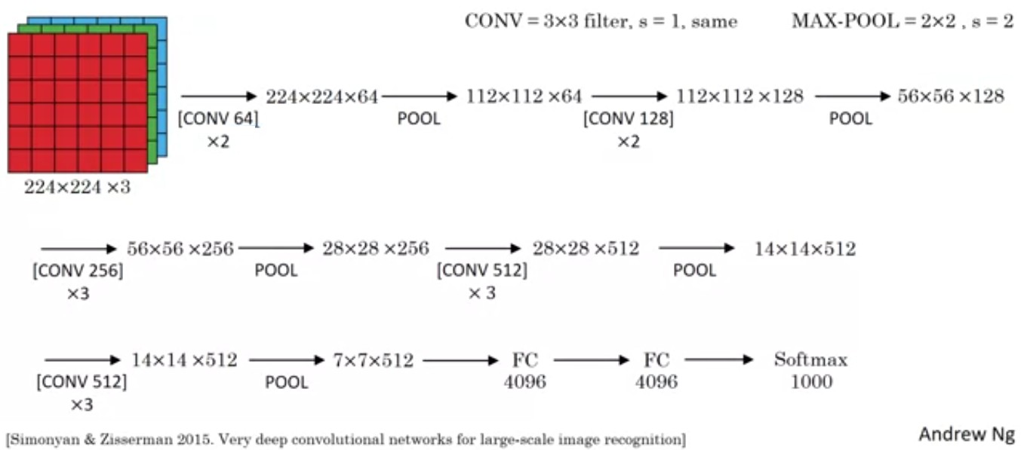
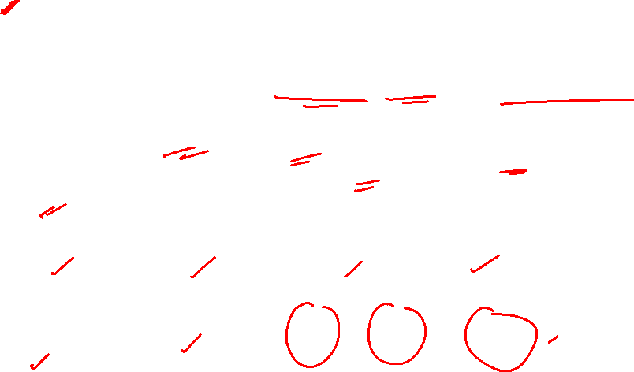
VGG 16

Slide 21
GoogLeNet / Inception Net
ILSVRC’14 classification winner (6.7% top 5 error) 22 layers with weights
Only 5 million parameters (12x less than AlexNet and 27x less than VGG-16)
Inception Module - convolutional “blocks” – efficient
Design a good local network topology (network within a network) and then stack these modules on top of each other.
Linear layers at the end
Max pooling in between, multiple Conv layers between pooling
Great ideas for data augmentation
Deeper networks, with computational efficiency
No FC layers.
After the last convolutional layer, a global average pooling layer is used that spatially averages across each feature map, before final FC layer.

Slide 22
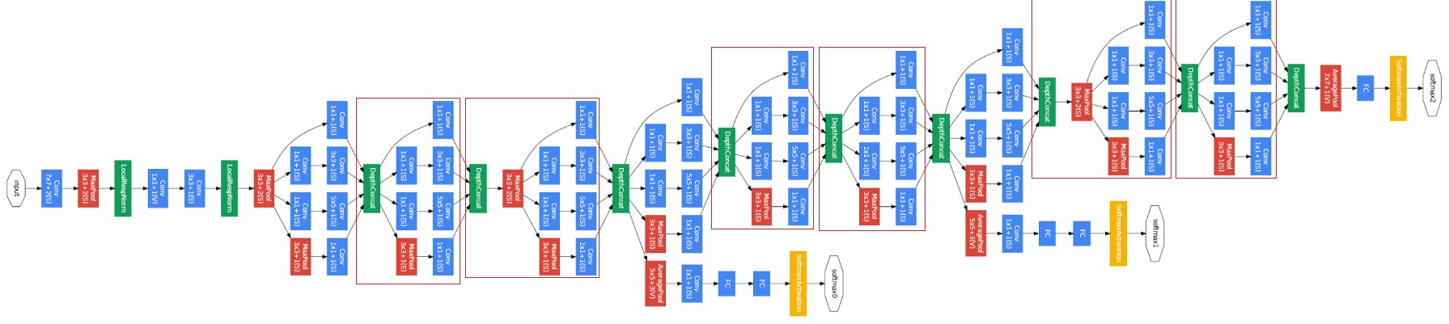
Inception Net

Slide 23
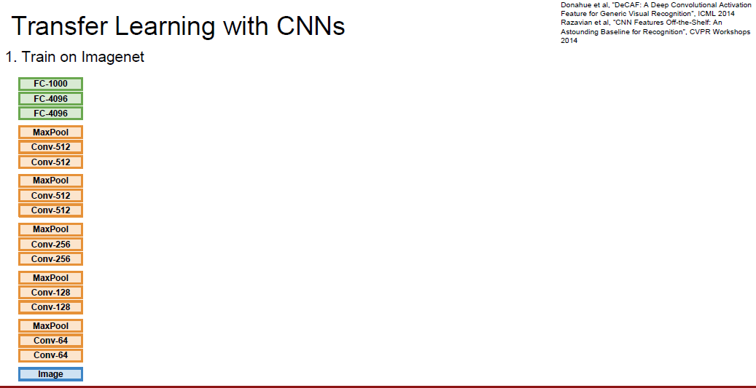

Transfer Learning

Slide 24
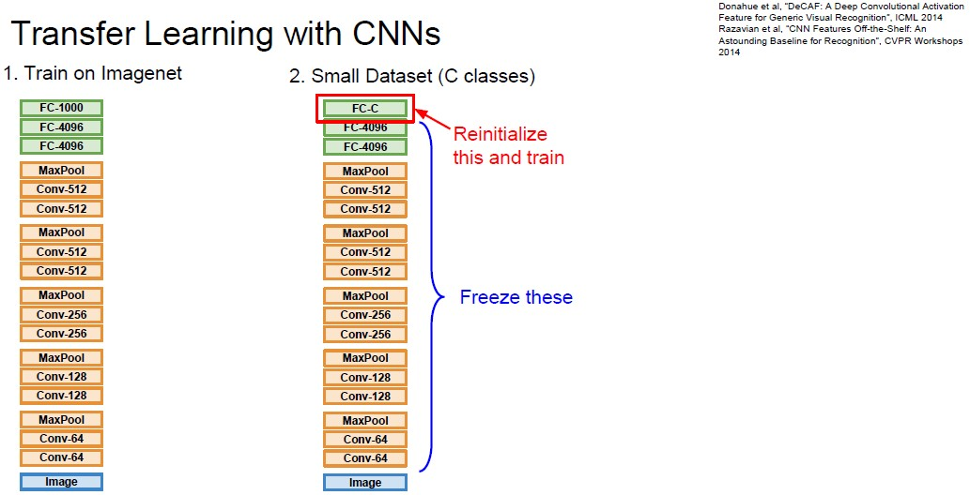
Transfer Learning

Slide 25
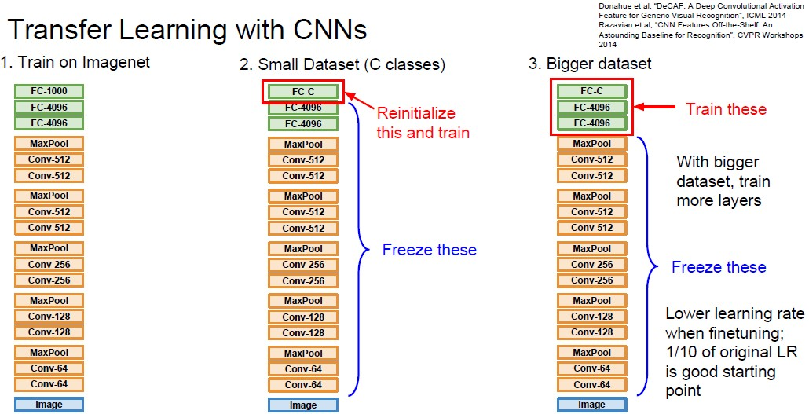
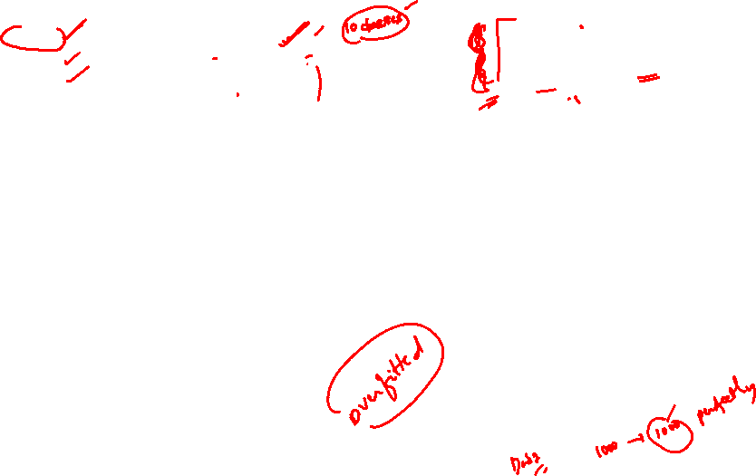
Transfer Learning

Slide 26
Transfer Learning for Image Data
Use a deep learning model that is pre-trained on large dataset like ImageNet or MS Coco.
Oxford VGG Model
Google Inception
Model Microsoft
ResNet Model

Slide 27
Transfer Learning for Text Data
Embedding is the mapping of words to a high-dimensional continuous vector space where different words with similar meanings have similar vector representations.
Google’s word2vec Model
Stanford’s GloVe Model
FastText
Gensim

Slide 28
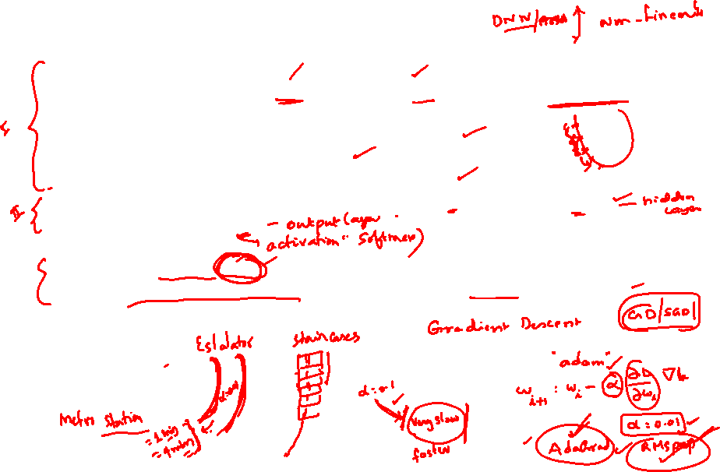
model = models.Sequential()
model.add(layers.Conv2D(32, (3, 3), activation='relu', input_shape=(32, 32, 3)))
model.add(layers.MaxPooling2D((2, 2)))
model.add(layers.Conv2D(64, (3, 3), activation='relu'))
model.add(layers.MaxPooling2D((2, 2)))
model.add(layers.Conv2D(64, (3, 3), activation='relu'))
model.add(layers.Flatten()) model.add(layers.Dense(64, activation='relu'))
model.add(layers.Dense(10))
model.compile(optimizer='adam', es.SparseCategoricalCrossentropy(from_logits=True), metrics=['accuracy'])

Slide 29

Transfer Learning - when to use?
You need a lot of a data if you want to train/use CNNs / RNNs.
Task A and Task B have the same type of input. Eg: Input is images for both tasks.
We have lot of data for training Task A and relatively low data for training in Task B.
Low level features obtained from Task A could be more helpful for learning Task B.

Slide 30
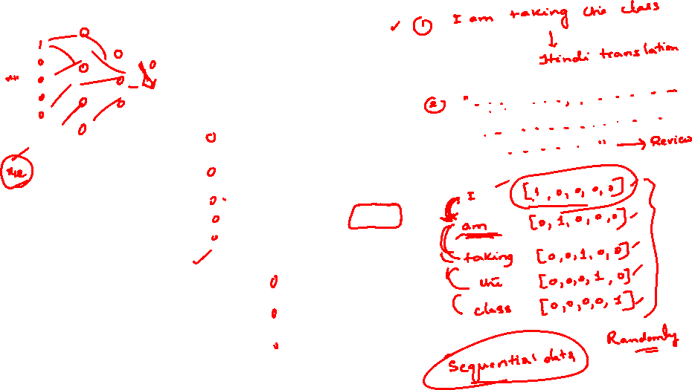
MODULE # 7 :
RNN

Slide 31

Example: Auto-completion
This is not true in many applications.
The size of the input is not always fixed.
Successive inputs may not be independent of each other.
Each network (blue - orange - green structure) is performing the same task –
input : character
output : character.
Example: Auto-completion.
e e
p
eow
d
e e
p

Slide 32
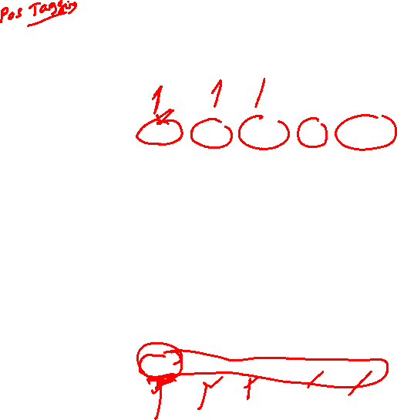
Part of Speech Tagging
Task is predicting the part of speech tag (noun, adverb, adjective, verb) of each word in a sentence.
When we see an adjective we are almost sure, the next word should be a noun.
The current output depends on the current input as well as the previous input.
The size of the input is not fixed. Sentences have any number of words.
An output is produced at end of each time step.
Each network is performing the same task – input : word, output : tag.
noun
verb
article adj
noun
Apple is a
red fruit

Slide 33
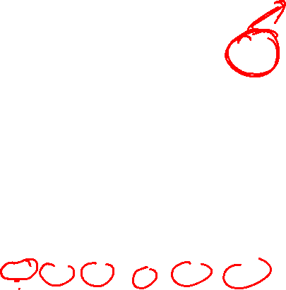
Sentiment Analysis
Task is predicting the sentiment of a whole sentence.
Input is the entire sequence of inputs.
An output is not produced at end of each time step.
Each network is performing the same task –
input : word,
output : polarity +/−.
(-)
The movie was
boring and
long

Slide 34


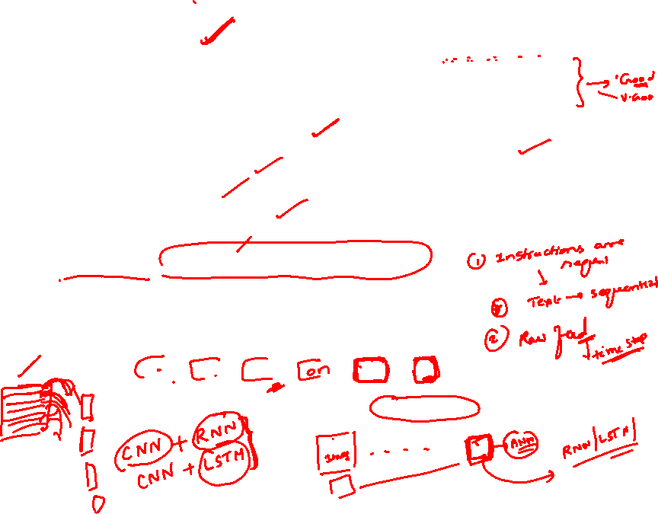
Motivation: Why Sequence Models?
Many real-world problems involve sequential data:
Natural Language: ”The cat sat on the ”
Time Series Forecasting: Stock prices, temperature prediction, sensor data
Speech: Audio signals over time
Video: Frame sequences
Genomics: DNA/protein sequences
Key characteristic:
Order matters Dependencies exist across time steps
The
Cat sat on
the
?
Dependencies

Slide 35
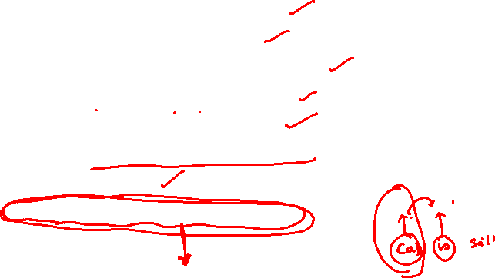
Sequence Learning Problems
To model a sequence we need
Process an input or sequence of inputs.
The inputs may have be dependent.
We may have to maintain the sequence order.
Each input corresponds to one time step.
Keep track of long term dependencies.
Produce an output or sequence of outputs.
Supervised Learning.
Share parameters across the sequences.

Slide 36
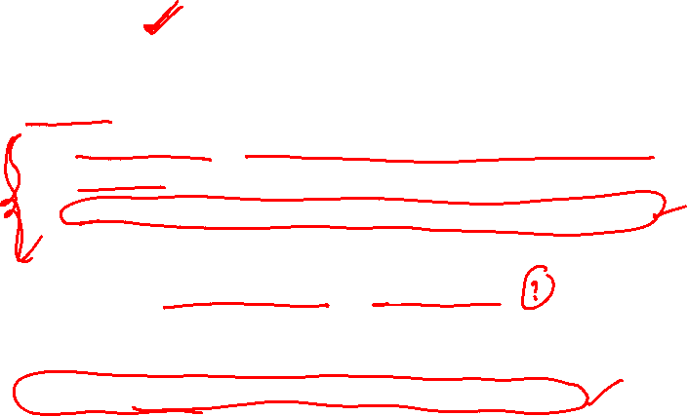
Why Feedforward Networks Fail?
Key issues:
Fixed input size: Cannot handle variable-length sequences
No memory: Each input processed independently
No parameter sharing: Different weights for each position
Example Problem: Predict next word in a sentence
Input: ”I grew up in France, so I speak fluent ”
Need context from 7 words back (”France”) to predict ”French”
Feedforward network treats each position independently
We need: A model that can remember past information

Slide 37
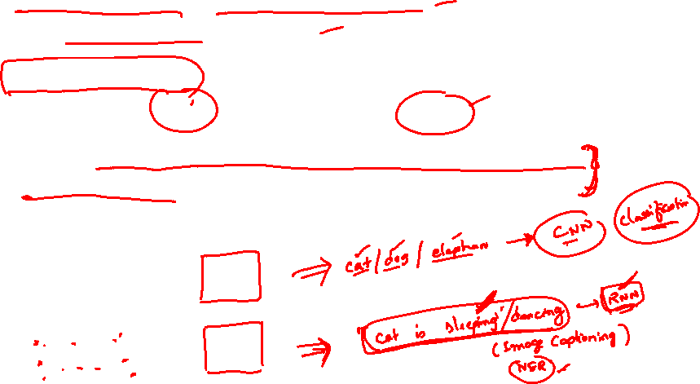
Temporal Dependencies
Short-term dependencies: Information needed is recent
”The clouds are in the ” → ”sky”
Long-term dependencies: Information needed is far back
”I grew up in France... I speak fluent ” → ”French”
Challenge: Model must learn to remember relevant information and forget irrelevant information.
Different sequence lengths require flexible architectures

Slide 38
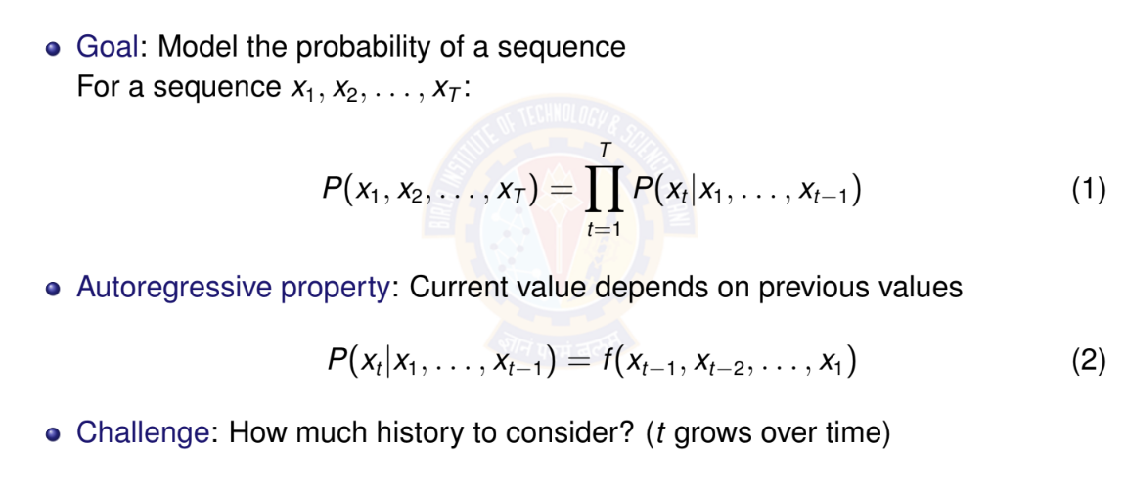
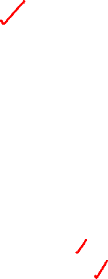
Autoregressive Models

Slide 39
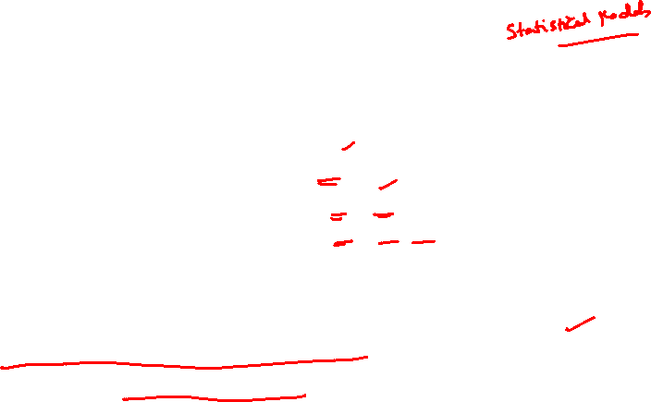
Autoregressive Models: Example
Sequence: ”The cat sat on the” Predict: Next word (e.g., ”mat”) Autoregressive decomposition:
P (The, cat, sat, on, the, mat) = P(The)
× P(cat|The)
× P(sat|The, cat)
× P(on|The, cat, sat)
× P(the|The, cat, sat, on)
× P(mat|The, cat, sat, on, the)
Each word depends on ALL previous words
History grows with sequence length

Slide 40

Markov Assumption
Simplification: Limit the context window
First-order Markov: Only immediate past matters
P(x_{t} |x₁, . . . , x_{t —1}) ≈ P(x_{t} |x_{t —1})
(3)
k -th order Markov: Last k steps matter
P(x_{t} |x₁, . . . , x_{t —1}) ≈ P(x_{t} |x_{t —k} , . . . , x_{t —1})
(4)
Advantage: Fixed-size context, tractable computation
Disadvantage: May lose important long-term dependencies

Slide 41
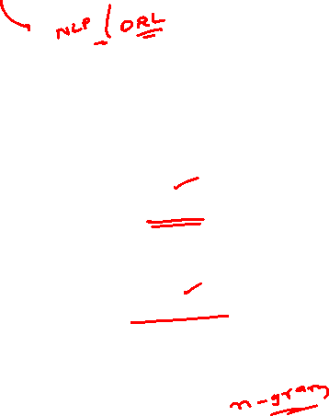
Markov Assumption: Example
Sequence: ”The cat sat on the”
Predict: Next word (e.g., ”mat”)
First-order Markov (bigram):
P(mat|The, cat, sat, on, the) ≈ P(mat|the)
Second-order Markov (trigram):
P(mat|The, cat, sat, on, the) ≈ P(mat|on, the)
Key insight:
Fixed context window (1 or 2 words)
Ignores earlier words like ”cat” and ”sat”
Computationally efficient but limited expressiveness

Slide 42
Latent Variable Models
Alternative approach: Summarize past with a hidden state
h_{t} = f (x_{t} , h_{t —1})
P(x_{t} |x₁, . . . , x_{t —1}) = P(x_{t} |h_{t} )
(5)
(6)
Key insight:
⁾ h_{t} is a latent (hidden) variable
⁾ Contains compressed summary of history
⁾ Fixed-size representation regardless of sequence length
⁾ Updated recursively at each time step
This is the foundation of RNNs!

Slide 43
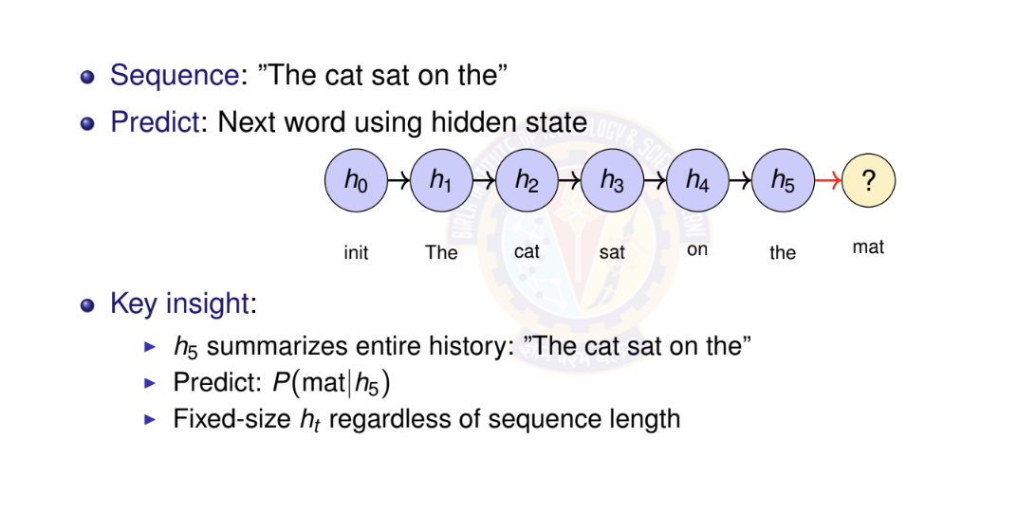
Latent Variable Models: Example

Slide 44
Numerical Example: Temperature Forecasting - Setup
Task: Predict tomorrow’s temperature (regression)
Observed sequence: 20◦C, 22◦C, 25◦C, 24◦C, 21◦C
Approach 1: Autoregressive (First-order)
Linear relationship learned from data:
T_{t +1} = α · T_{t} + β
From historical data, we learned:
α = 0.8, β = 4.0
Example: If today is 25◦C:
T_{tomorrow} = 0.8 × 25 + 4.0 = 24.0◦C

Slide 45
Temperature Forecasting - Autoregressive Prediction
Sequence: 20◦C, 22◦C, 25◦C, 24◦C, 21◦C
Model: T_{t +1} = 0.8 · T_{t} + 4.0
Predict next day (day 6):
Last observation: T₅ = 21◦C
Prediction: T₆ = 0.8 × 21 + 4.0 = 20.8◦C
Multi-step ahead (day 7, using predicted T₆):
T₇ = 0.8 × 20.8 + 4.0 = 20.64◦C
Limitation: Only uses immediate past
Cannot capture weekly/seasonal patterns
Error accumulates in multi-step predictions

Slide 46
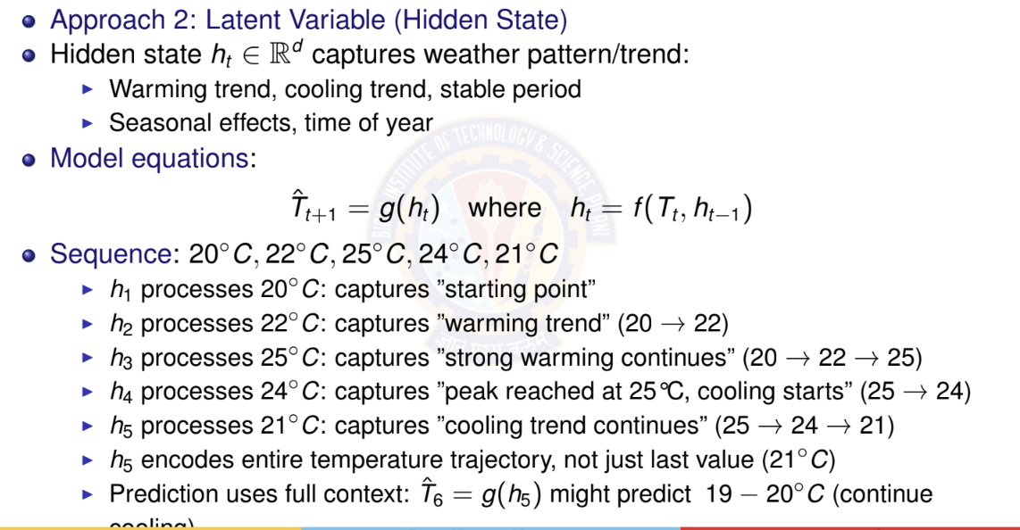
Temperature Forecasting - Latent Variable Model

Slide 47

Recurrent Neural Network (RNN)
Definition
Neural network with loops, allowing information to persist
Key idea:
Process sequential data one step at a time
Maintain hidden state that summarizes past information
Same parameters shared across all time steps
The loop: Hidden state h_{t} feeds back into itself at next time step
o_{t}
h_{t}
RNN
Recurrent connection
x_{t}

Slide 48
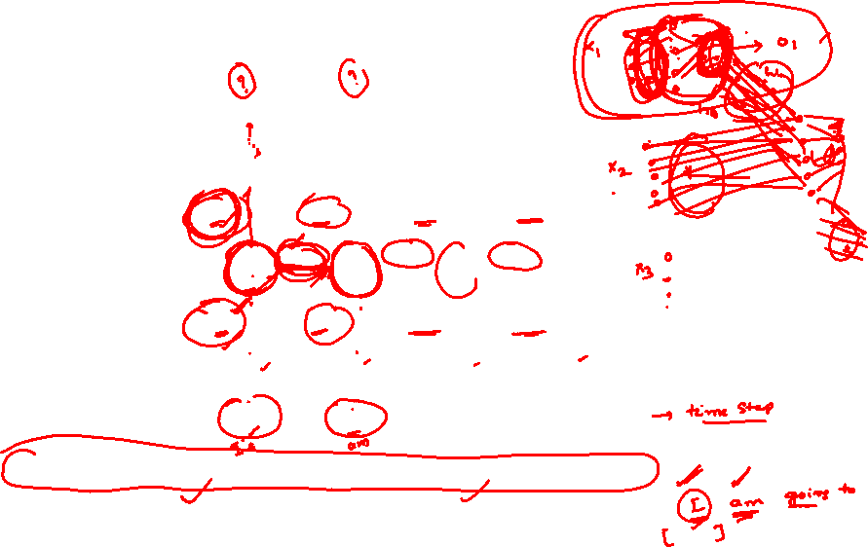
RNN: Unrolled Computation Graph
Unrolling: Visualize RNN across time steps
o₁ o₂ o₃ o₄
same W_{ho}
same W_{ho}
same W_{ho}
same W_{ho}
h₁
same W_{hh}
h₂
same W_{hh}
h₃
same W_{hh}
h₄ · · ·
same W_{hx}
same W_{hx}
same W_{hx}
same W_{hx}
x₁
t = 1
x₂
t = 2
x₃
t = 3
x₄
t = 4
Key insight: Same parameters (W_{hx} , W_{hh}, W_{ho} ) applied at each time step

Slide 49
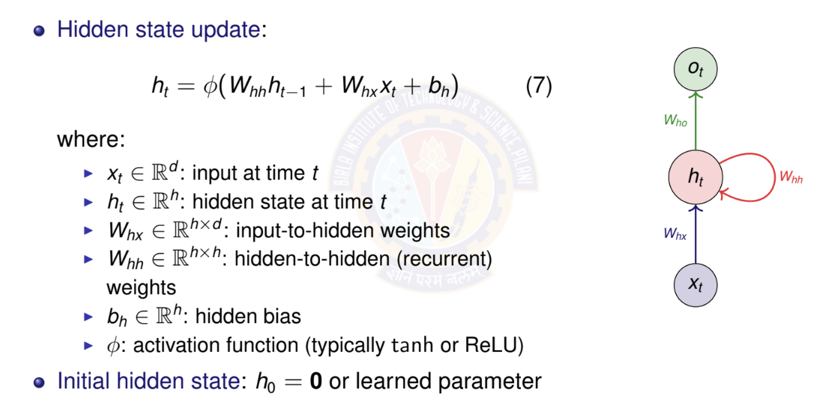
RNN Mathematical Formulation I

Slide 50
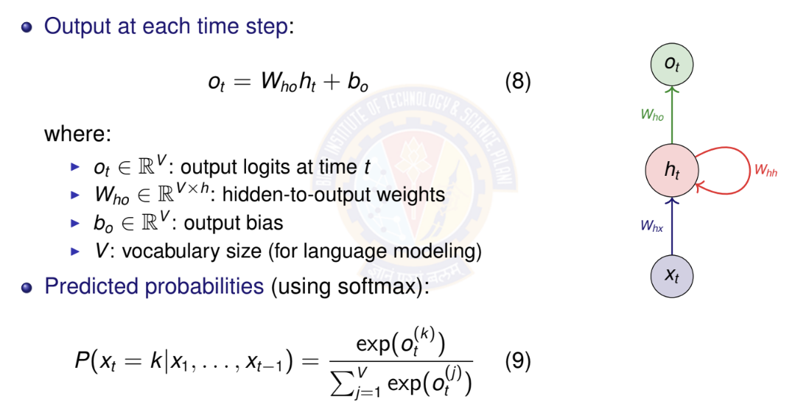
RNN Mathematical Formulation II

Slide 51
Parameter Sharing Across Time
Key insight: Same parameters used at every time step
W_{hx} , W_{hh} , b_{h} : Shared across all time steps
W_{ho} , b_{o} : Shared across all time steps
Advantages:
Fixed number of parameters regardless of sequence length
Can process sequences of any length
Generalization: patterns learned at one position transfer to others
Contrast with feedforward: Different weights for each position

Slide 52
RNN Parameter Counting
Given:
Input dimension: d
Hidden dimension: h
Output/vocabulary size: V
Parameter count:
W_{hx} : h × d W_{hh} : h × h
b_{h} : h
W_{ho} : V × h b_{o} : V
Total : hd + h² + h + Vh + V = h(d + h + V + 1) + V

Slide 53
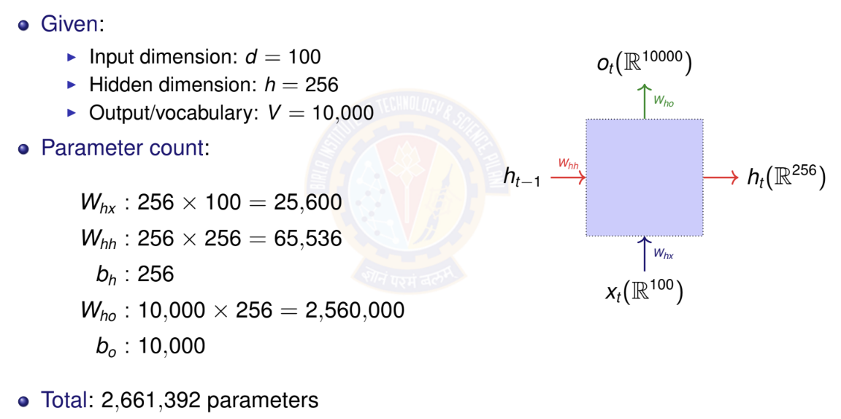
RNN Parameter Counting Example

Slide 54
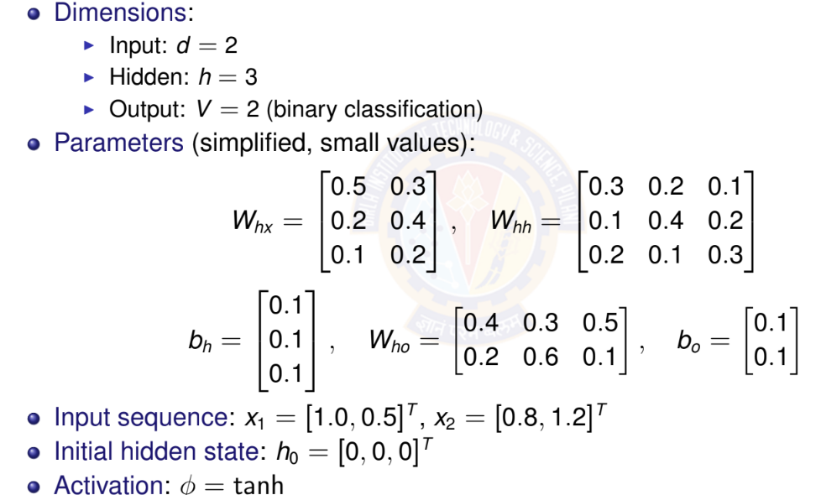
RNN Forward Pass: Simple Example

Slide 55
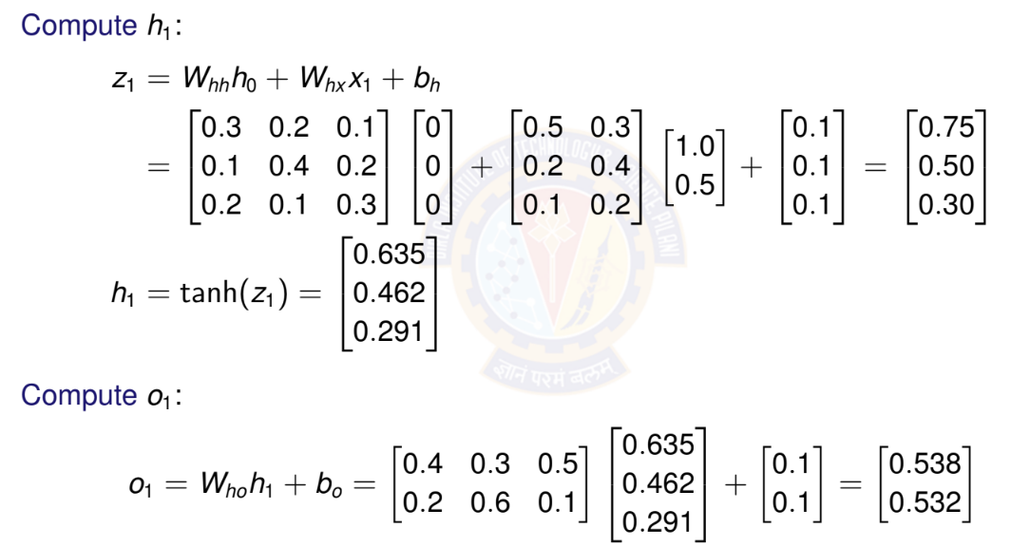
RNN Forward Pass: Time Step t = 1

Slide 56
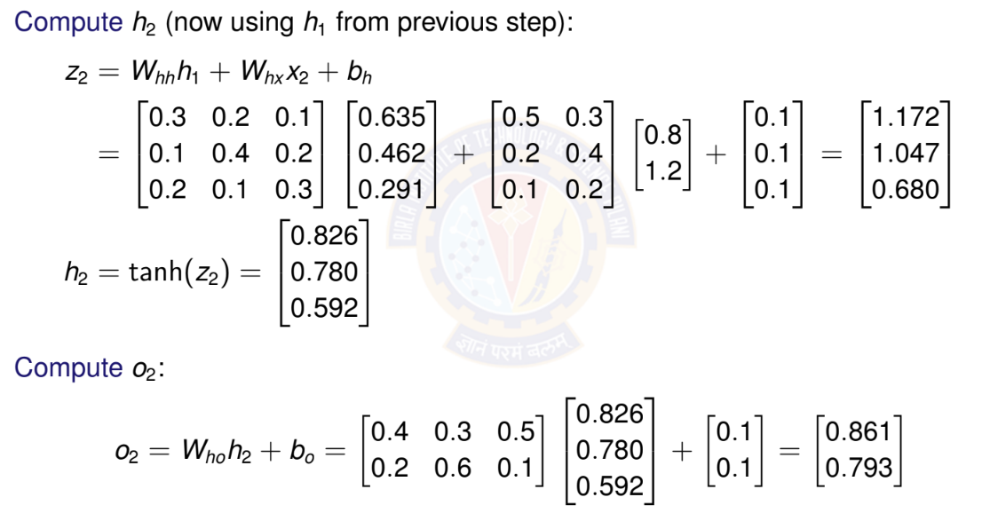
RNN Forward Pass: Time Step t = 2

Slide 57
Activation Functions in RNNs
Common choices for φ:
Hyperbolic tangent (tanh):
⁾ Range: [−1, 1]
⁾ Centered at zero (helps with gradient flow)
⁾ Most common for vanilla RNNs
ReLU:
⁾ Range: [0, ∞)
⁾ Can help with vanishing gradient
⁾ May cause exploding activations

Slide 58
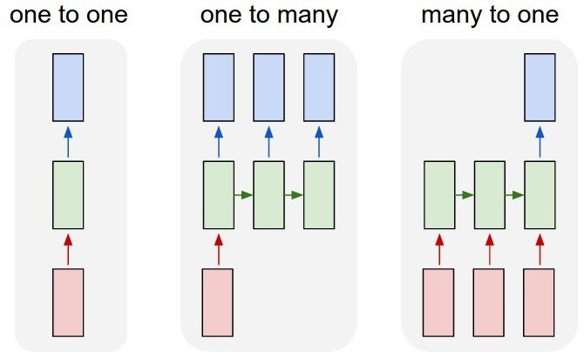
Types of RNN
Courtesy: Andrej Karpathy

Slide 59
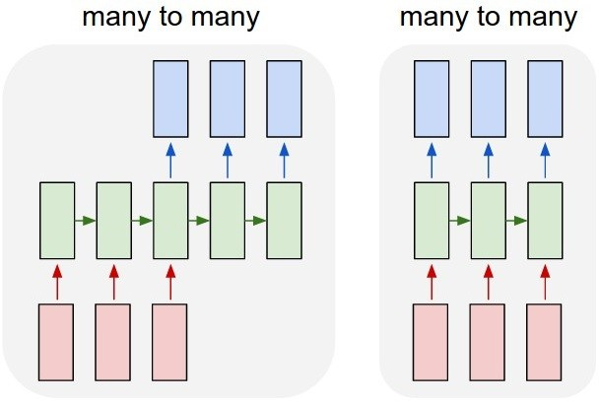
Types of RNN
Courtesy: Andrej Karpathy

Slide 60
Types of RNN and Applications
One to one – Generic neural network, Image classification
One to many – Music generation, Image Captioning
Many to one – Movie review or Sentiment Analysis
Many to many – Machine translation Synced
Many to many – Video classification

Slide 61
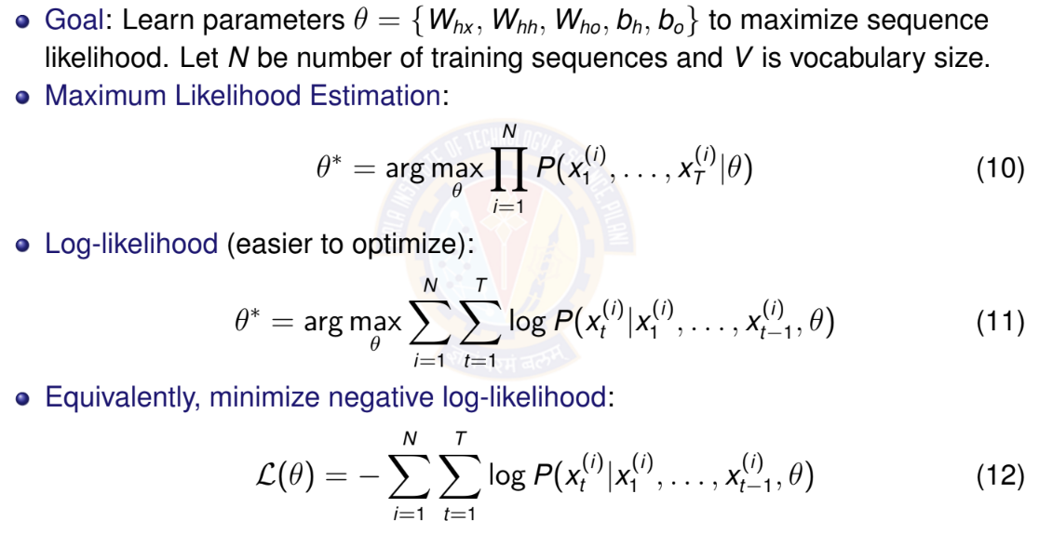
Training Objective for RNNs

Slide 62
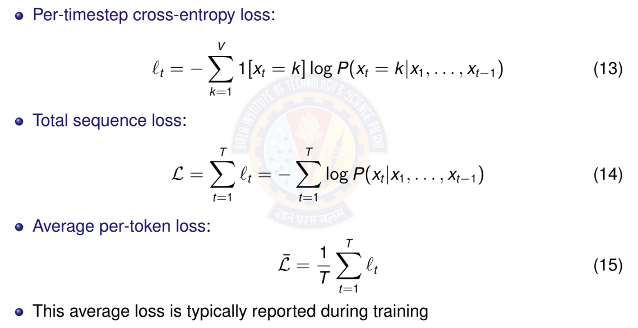
Loss Function for Sequences

Slide 63
Backpropagation Through Time (BPTT)
Challenge: How to compute gradients in RNNs?
⁾ Parameters shared across all time steps
⁾ Hidden state depends on entire history
⁾ Need to backpropagate through time
Key insight: Unroll RNN into feedforward network
⁾ Apply standard backpropagation
⁾ Sum gradients from all time steps (parameter sharing)
BPTT: Backpropagation Through Time
⁾ Forward pass: compute outputs for all time steps
⁾ Backward pass: compute gradients from t = T to t = 1
⁾ Gradients flow backward through time

Slide 64
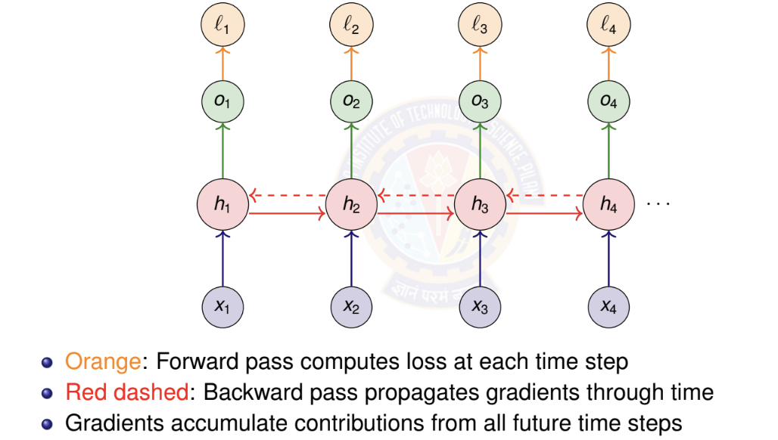
BPTT: Computational Graph

Slide 65
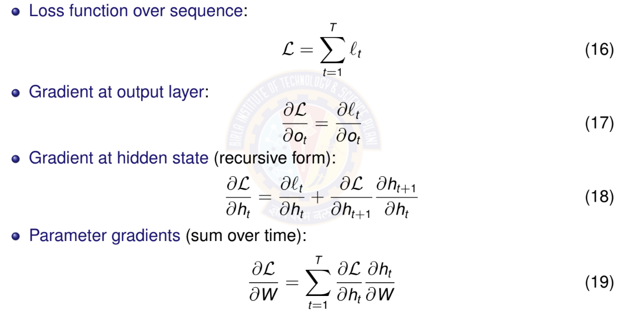
BPTT: Key Gradient Equations

Slide 66
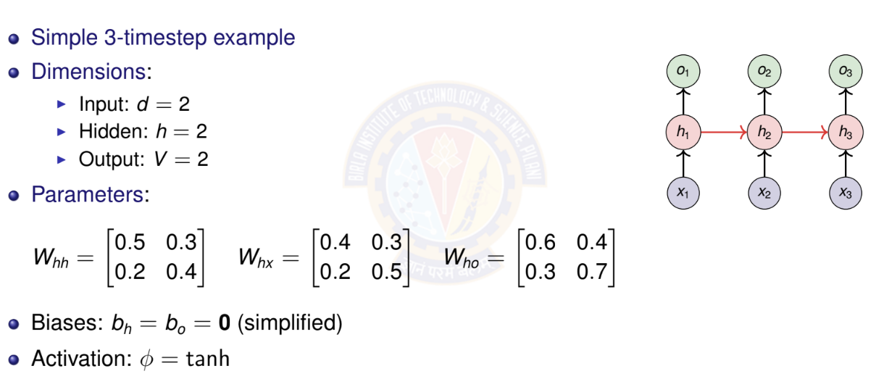
BPTT: Numerical Example Setup

Slide 67
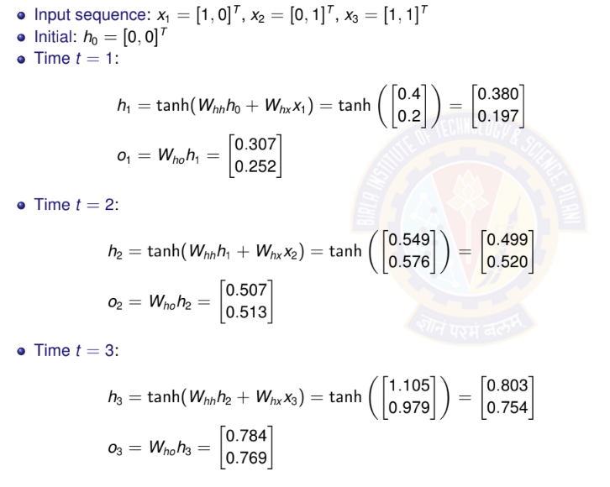
BPTT: Forward Pass

Slide 68
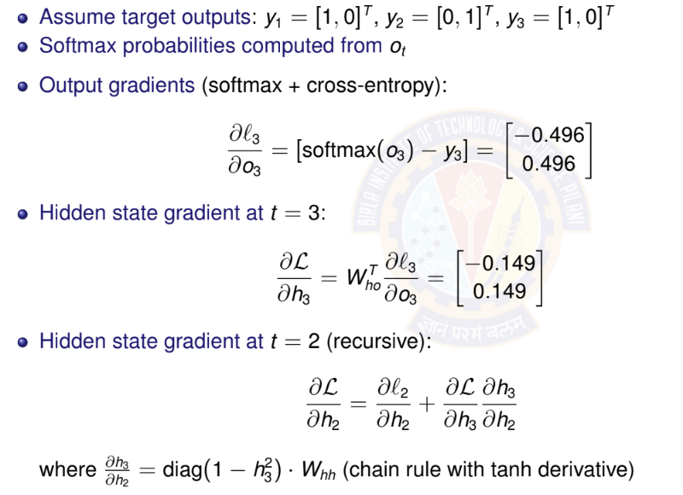
BPTT: Backward Pass

Slide 69
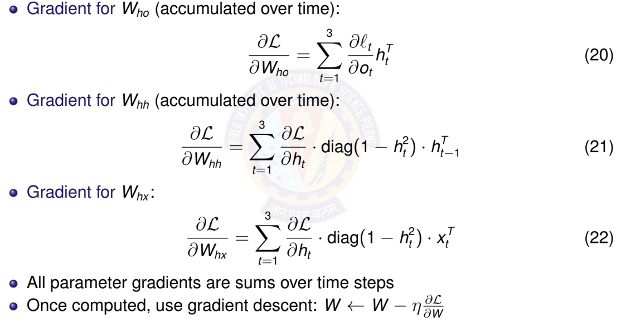
BPTT: Parameter Gradients

Slide 70
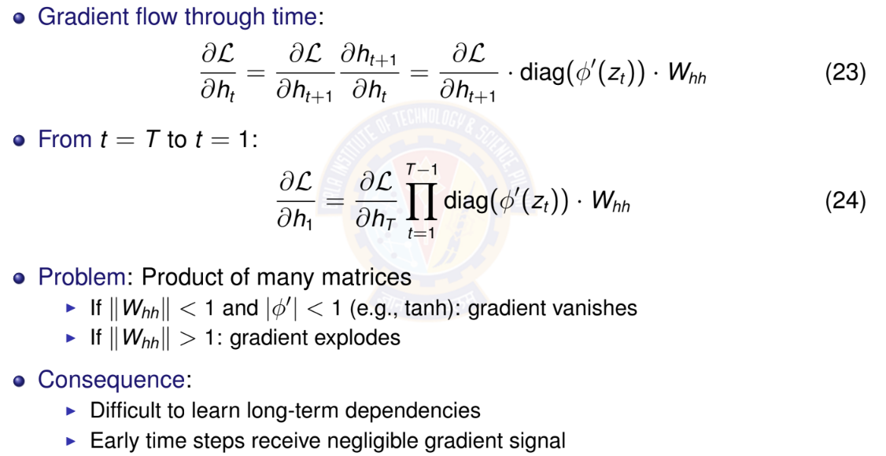
Vanishing Gradients: The Problem

Slide 71

Vanishing Gradients: Numerical Example

Slide 72
Why Vanishing Gradients are Problematic?
Learning difficulty:
Parameters affecting early time steps barely update
Model cannot learn long-term patterns
Training becomes ineffective for long sequences
Example scenarios where this fails:
”I grew up in France... [50 words]... I speak fluent ”
Long-range syntactic dependencies in language
Time series with seasonal patterns (yearly cycles)
Solutions:
Better architectures: LSTM, GRU
Careful initialization
Skip connections

Slide 73
Bidirectional RNNs: Motivation
Limitation of standard RNN: Only uses past context
Predicts based on x₁, . . . , x_{t —1}
Cannot use future information
Many tasks benefit from full context:
Sentiment analysis: ”The movie was not ” (need to see ”good” or ”bad”)
Named entity recognition: ”I met Paris in Paris” (person vs city - need full context)
Speech recognition: Future phonemes help disambiguate current sound
Machine translation: Full sentence context improves translation
Key idea: Process sequence in both directions
Forward RNN: left-to-right
Backward RNN: right-to-left
Combine information from both

Slide 74

Bidirectional RNN Architecture

Slide 75

Bidirectional RNN: Mathematical Formula

Slide 76

Bidirectional RNN: Parameter Counting

Slide 77

Example Bidirectional RNN: Parameter Counting

Slide 78

Example Bidirectional RNN: Parameter Counting

Slide 79
When to Use Bidirectional RNNs
Use bidirectional RNNs when:
Entire sequence available before prediction
Task benefits from future context
Examples: text classification, named entity recognition, machine translation (encoder)
Do NOT use when:
Real-time/online prediction required
Causal modeling (future cannot influence past)
Examples: language modeling, real-time speech recognition, time series forecasting
Key limitation: Must process entire sequence
Cannot make predictions until sequence complete
Higher computational cost (two RNNs)
Not suitable for streaming applications

Slide 80
Deep (Stacked) RNNs: Motivation
Why stack RNN layers?
⁾ Single RNN layer: limited representational capacity
⁾ Deep networks learn hierarchical features
⁾ Lower layers: simple patterns
⁾ Higher layers: complex, abstract patterns
Examples of hierarchical features:
⁾ Text: characters → words → phrases → sentences
⁾ Speech: phonemes → syllables → words
⁾ Time series: short-term → medium-term → long-term trends
Empirical observation:
⁾ Deeper RNNs often outperform wider single-layer RNNs
⁾ Typical depth: 2-4 layers (diminishing returns beyond this)

Slide 81

Deep RNN Architecture
Each layer processes output of previous layer
Horizontal arrows: recurrent connections within layer
Vertical arrows:
feed-forward connections between layers
 | o₁ | o₂ | o₃
Layer 3 | _{h}(3) | _{h}(3) | _{h}(3) 3
Layer 2 | _{h}(2) | _{h}(2) | _{h}(2) 3
Layer 1 | _{h}(1) | _{h}(1) | _{h} (1)
1
2
1
2
1
2
3
x₁
x₂
x₃

Slide 82

Deep RNN: Mathematical Formulation

Slide 83

Deep RNN: Parameter Counting

Slide 84

Deep RNN: Numerical Example Setup

Slide 85

Deep RNN: Forward Pass at t = 1

Slide 86

Deep RNN: Forward Pass at t = 2

Slide 87
Deep RNN: Gradient Flow Considerations
Gradient must flow through:
Time (horizontal connections within each layer)
Depth (vertical connections between layers)
Compound vanishing gradient problem:
Gradients vanish in time dimension (as in single-layer RNN)
Additional vanishing through depth
Problem is more severe than single-layer RNN
Mitigation strategies:
Use LSTM/GRU cells instead of vanilla RNN (upcoming)
Skip connections between layers (residual connections)
Careful initialization
Layer normalization
Practical limit: Typically 2-4 layers
Deeper networks harder to train
Diminishing returns beyond 4 layers

Slide 88
GRU: Motivation
Vanilla RNN problems:
Vanishing gradients prevent learning long-term dependencies
All information in hidden state weighted equally
No mechanism to selectively remember or forget
Key insight: Use gates to control information flow
Gates: Neural network layers with sigmoid activation σ ∈ [0, 1]
σ = 0: Block information completely
σ = 1: Let all information pass through
σ ∈ (0, 1): Partially allow information
GRU advantages:
Learn what to remember and what to forget
Better gradient flow through time
Can capture long-term dependencies
Fewer parameters than LSTM

Slide 89


GRU – gated recurrent unit
(more compression)
LSTM
reset gate
Update gate
It combines the forget and input into a single update gate.
It also merges the cell state and hidden state.
This is simpler than LSTM. There are many other variants too.
X,*: element-wise multiply

Slide 90
GRU: Architecture Overview
Two gates:
⁾ Reset gate r_{t} : Controls how much past information to forget
⁾ Update gate z_{t} : Controls how much to update hidden state
Candidate hidden state h˜_{t} : Proposed new content
Final hidden state h_{t} : Interpolation between old and new
All gates learned from data
o_{t}
z_{t}
GRU
r_{t}
^{h}t —1
h_{t}
x_{t}

Slide 91

GRU: Unrolled Architecture Across Time
h
T

Slide 92

GRU: Reset Gate

Slide 93
GRU: Update Gate
Update gate equation:
z_{t}
z_{t} = σ(W_{z}x_{t} + U_{z}h_{t —1} + b_{z} )
Purpose: Decides how much to update hidden state
(32)
σ
^{h}t —1
⁾ z_{t} ≈ 0: Keep old hidden state h_{t —1} (don’t update)
⁾ z_{t} ≈ 1: Replace with new candidate h˜_{t} (full update)
⁾ Acts like a ”memory gate”
Intuition: For long-term dependencies, keep
z_{t} small to preserve information
x_{t}
Update Gate

Slide 94

GRU: Candidate Hidden State

Slide 95

GRU: Final Hidden State Update

Slide 96

GRU: Computational Graph

Slide 97

GRU: Numerical Example - Setup

Slide 98

GRU: Numerical Example - Gates Computation

Slide 99

GRU: Numerical Example - Hidden State Update

Slide 100

GRU: Numerical Example - Final Hidden State

Slide 101

GRU: Parameter Counting

Slide 102

GRU: Why It Helps with Vanishing Gradients

Slide 103
Long term dependency example
Example:
LM task: When she tried to print her tickets, she found that the printer was out of toner. She went to the stationery store to buy more toner. It was very overpriced. After installing the toner into the printer, she finally printed her
Dependency between “tickets” on the 7th step and the target word “tickets” at the end.

Slide 104
LSTM
Length of a sentence is an issue with RNN
Vanishing and exploding gradient are issues
LSTM is an extension for RNN , which basically extends the memory
LSTM can read , write and delete information from its memory
LSTN will have 3 gates
i.e. input gate , forget gate and output gate

Slide 105
Long Short Term Memory - LSTM
Building block of an LSTM is a memory cell, which replaces the hidden layer of standard RNNs
LSTM unit consists of
  Cell state (C_{t}​) → Responsible for carrying long-term memory.
  Hidden state (h_{t}​) → Represents the output at each time step.
  Three gates → Forget Gate, Input Gate, and Output Gate
LSTM has many variants which include different number of gates and also different arrangement of gates
Another equally popular variant of LSTM is Gated Recurrent Unit(GRU)

Slide 106
LSTM: Motivation
GRU limitations:
⁾ Single hidden state combines both long-term and short-term information
⁾ Update gate controls both memory and output together
⁾ Less explicit control over information flow
LSTM innovation: Separate memory from hidden state
⁾ Cell state c_{t} : Long-term memory (information highway)
⁾ Hidden state h_{t} : Short-term memory (working memory)
⁾ More fine-grained control with 3 gates instead of 2
Key advantages:
⁾ Cell state provides uninterrupted gradient flow
⁾ Forget gate can selectively remove information
⁾ Output gate separates what to remember from what to output
⁾ Better for very long sequences (100+ time steps)
Most widely used RNN variant in practice

Slide 107

LSTM: Architecture Overview

Slide 108






i_{t} decides what component
is to be updated.
C’_{t} provides change contents
Updating the cell state
Decide what part of the cell
state to output

Slide 109

LSTM: Unrolled Architecture Across Time

Slide 110

LSTM: Forget Gate

Slide 111

LSTM: Input Gate and Candidate

Slide 112

LSTM: Cell State Update

Slide 113

LSTM: Output Gate and Hidden State

Slide 114

LSTM: Computational Graph

Slide 115

LSTM: Parameter Counting

Slide 116

LSTM: Why It Solves Vanishing Gradients

Slide 117
LSTM vs GRU: Comparison
Property | GRU | LSTM
Number of gates | 2 (reset, update) | 3 (forget, input, output)
Memory types | 1 (hidden state) | 2 (cell + hidden)
Parameters | 3(hd + h² + h) | 4(hd + h² + h)
Relative params | Fewer (∼ 25% less) | More
Training speed | Faster | Slower
Memory usage | Lower | Higher
Gradient flow | Good | Excellent
Long sequences | Good (50-100 steps) | Better (100+ steps)
Popularity | Increasing | Most widely used
When to use GRU: Smaller datasets, shorter sequences, faster training
When to use LSTM: Longer sequences, more data available, maximum performance needed

Slide 118
LSTM Vs GRU
 | LSTM | GRU
Gates | 3 (Forget, Input, Output) | 2 (Reset, Update)
Cell State | Yes (separate from hidden state) | No (merged with hidden state)
Memory Retention | Better for long-term dependencies | Slightly less effective
Training Speed | Slower due to more computations | Faster (fewer parameters)
Best Use Case | Long sequences (e.g., machine translation, time-series) | Short sequences, quick training (e.g., speech recognition)

Slide 119


(c)GRU

Slide 120

RNN Architectures: Comparison

Slide 121
Summary
Use GRU, when dependency is short. Eg: Weather forecasting
Use LSTM, when dependency is long. Eg: NLP Translation
Use BRNN, dependency is in both direction. Eg: Stock prediction

Slide 122


